Slide 1
Process & Safety Valve assembly
Mike Kamerman
Mats Heusinkveld
Mark Holtjer
Daan Homma
Daniël Lammers

Slide 2
Contents
Goal
Process flow
Setup
Simulation
Safety
Conclusion

Slide 3
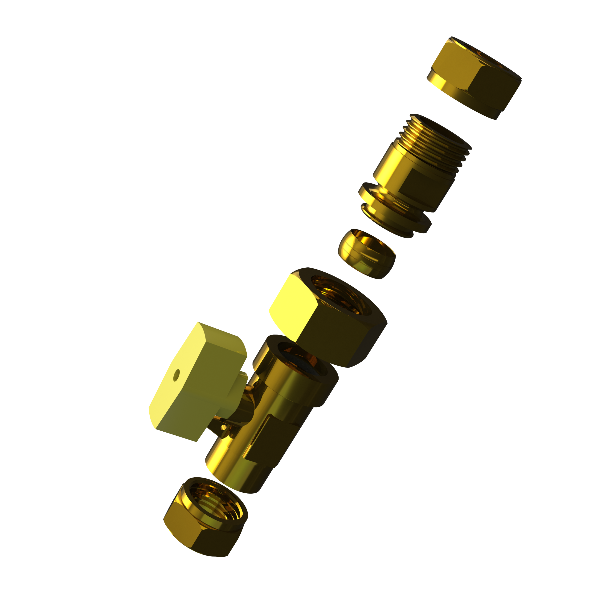
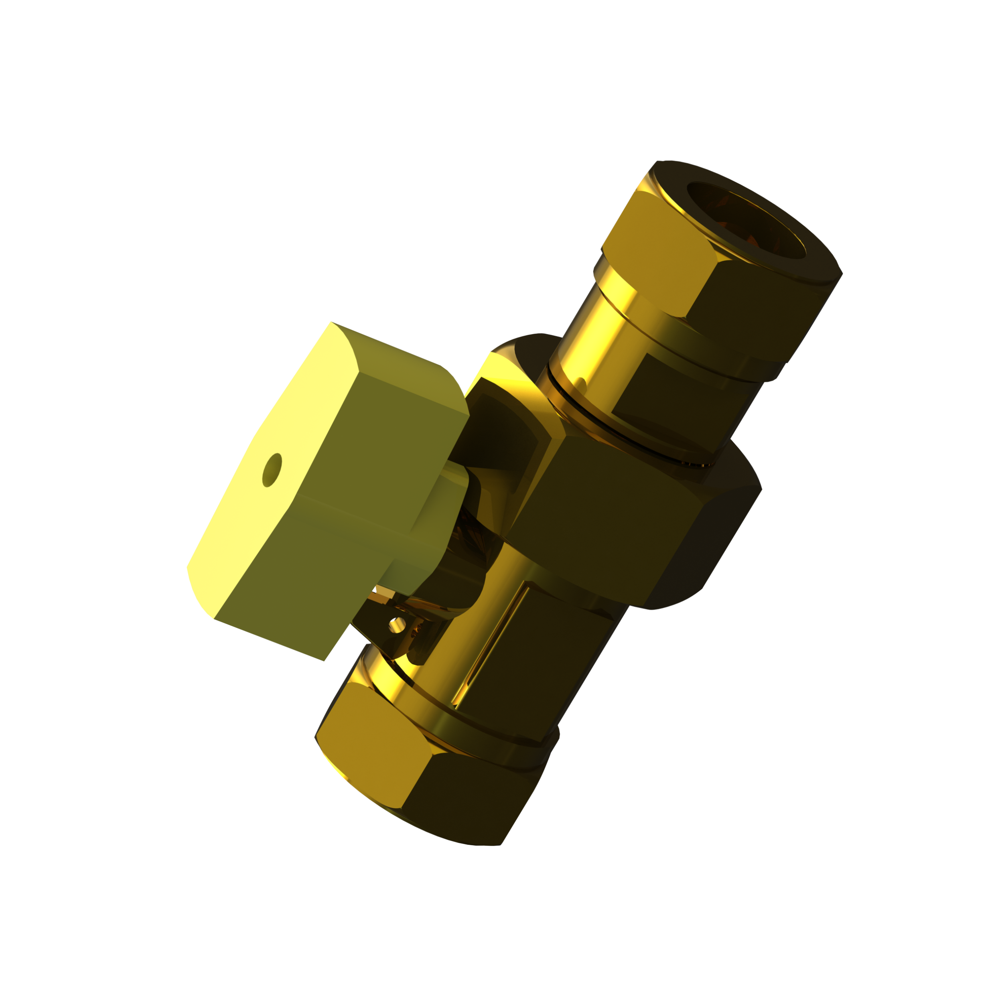
Goal
Valve assembly
Process communication
Safe operation

Slide 4
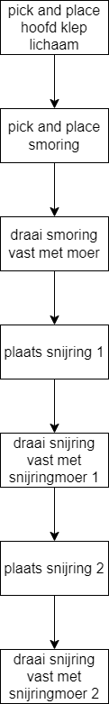
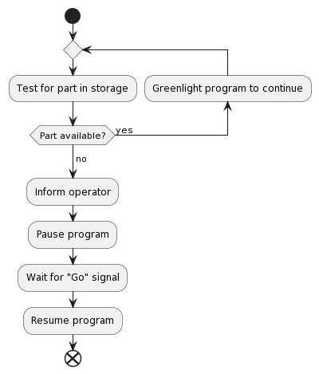
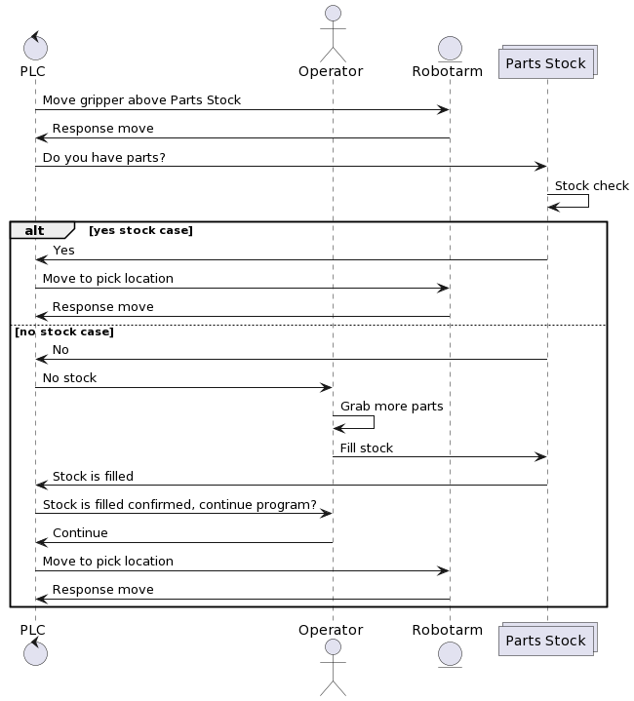
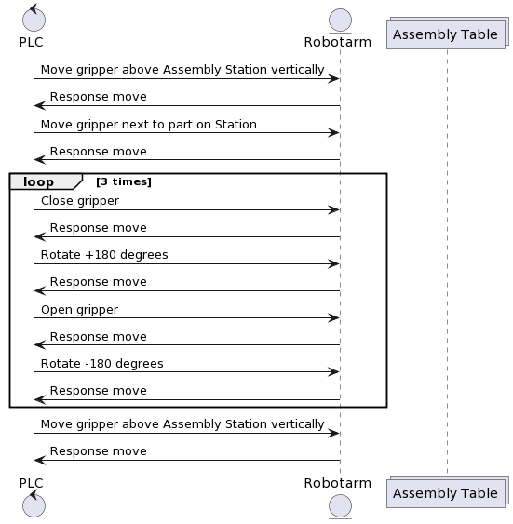
Process flow

Slide 5
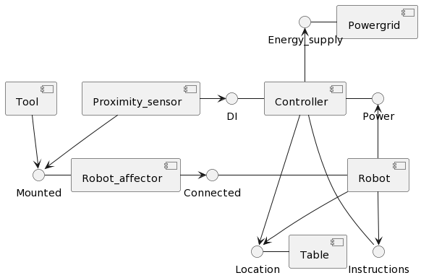
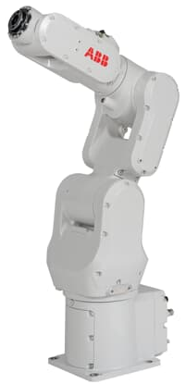
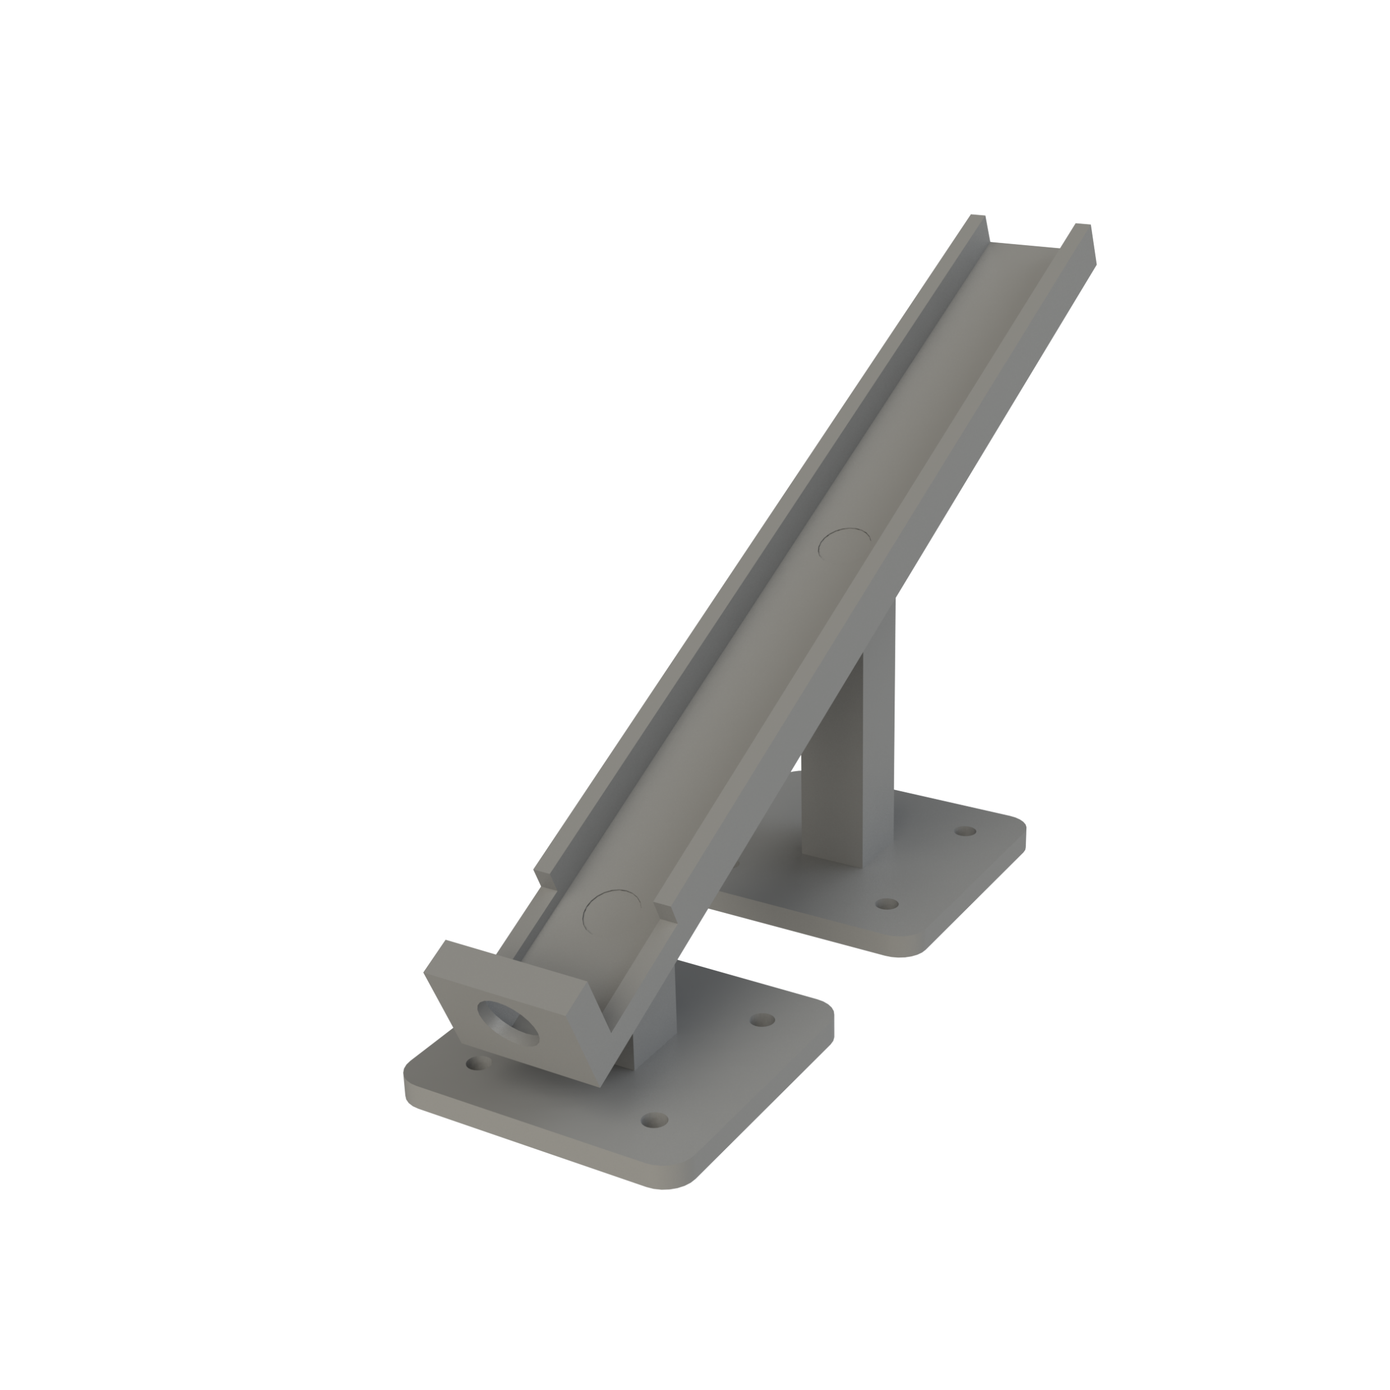
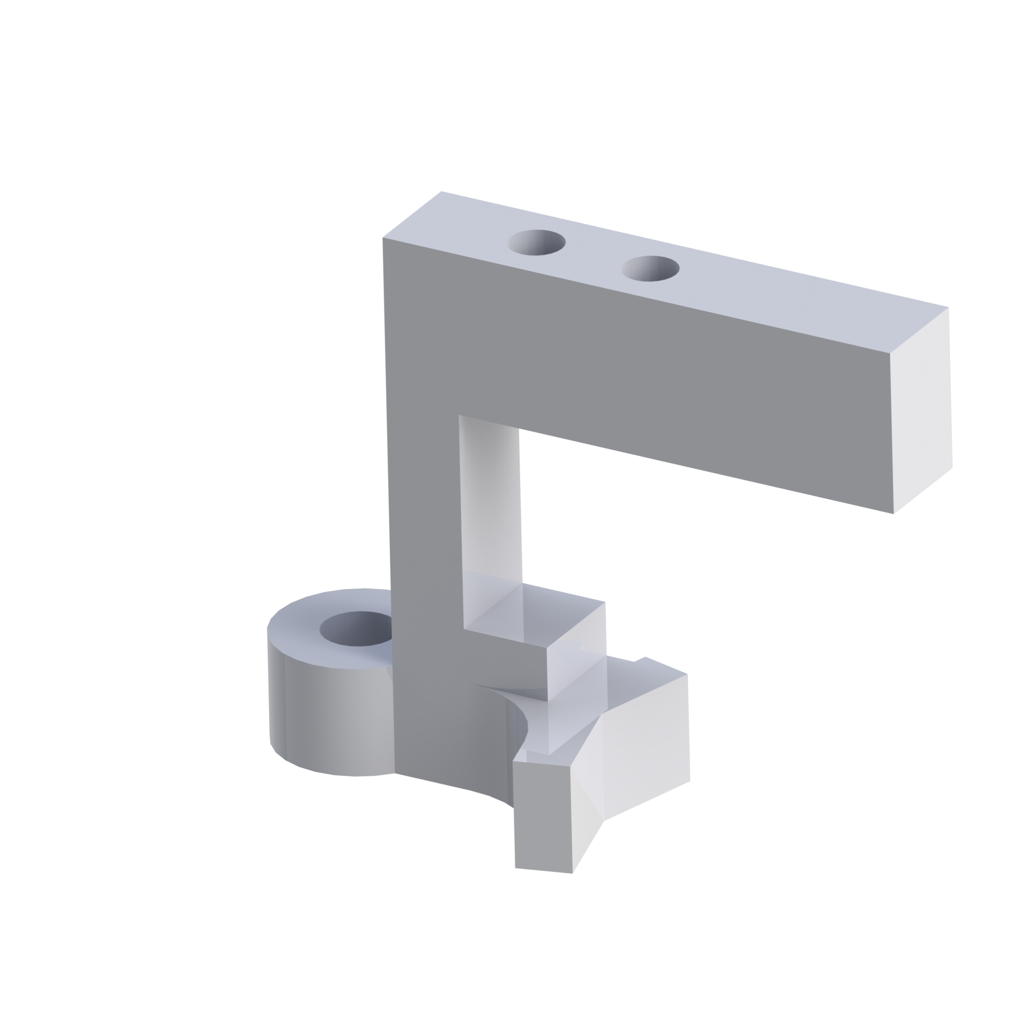
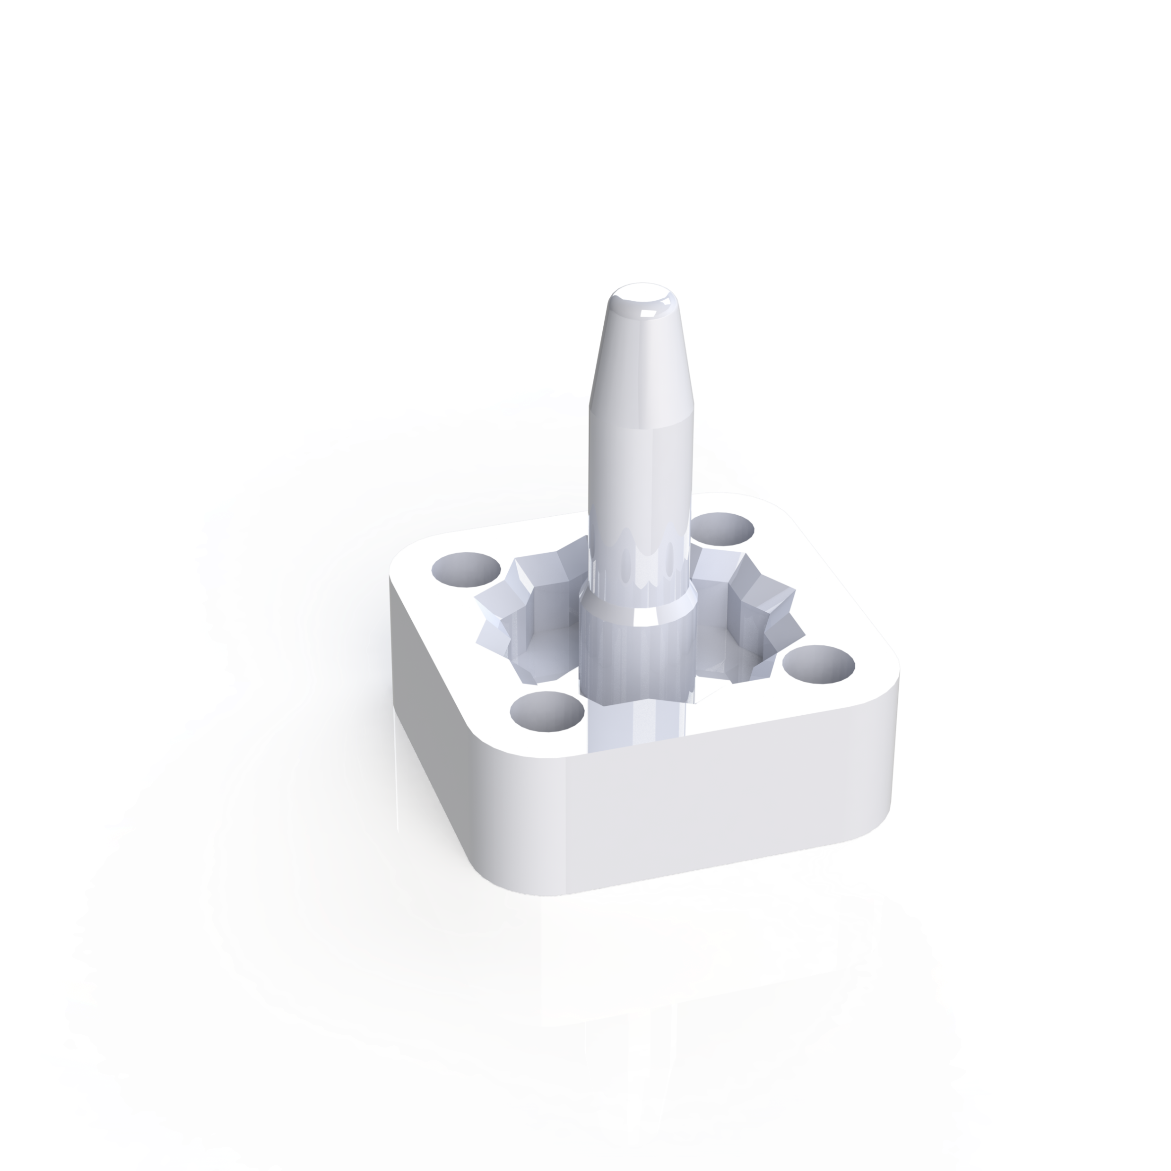
Setup
Part slides
Assembly pin
Gripper
Proximity sensor
Robot

Slide 6
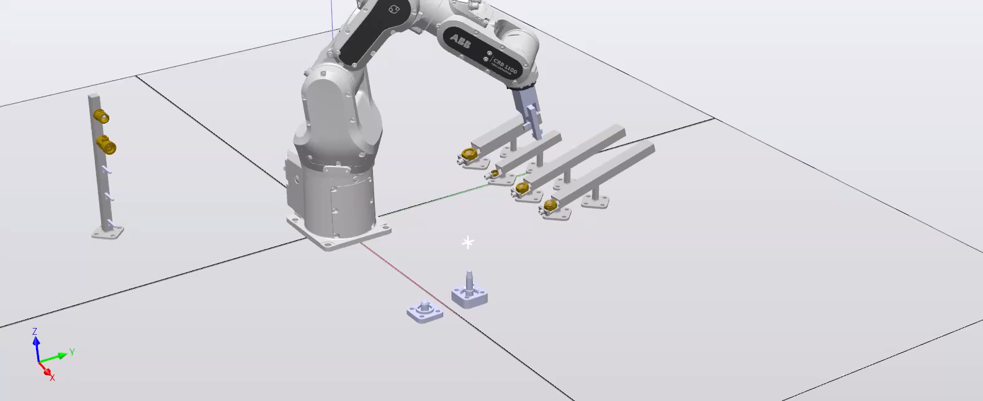
Simulation

Slide 7
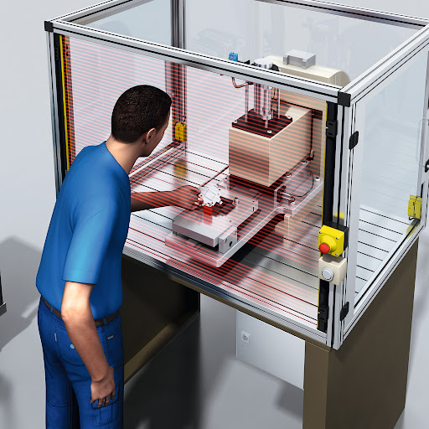
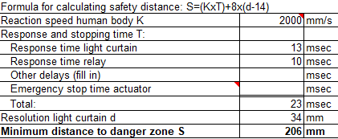
Safety
Risks
Prevention
Light curtains
Operator education
Maintenance

Slide 8
Conclusion

